Slide 1
1st Threat and Risk Information Exchange Day
Focus on Technologies and Capabilities for Situational Awareness and Information Sharing
Patrick Sack
CTO, Oracle National Security Group

Slide 2




















Oracle’s R&D drives Standards and Technologies for all Industries
11 of Top 11
Over 300 OEMs & Suppliers
5 of Top 10 Global
20 of Top 20 Service Providers
65 of Top 100
Aero & Defense
Automotive
Chemicals
Communications
Consumer Products
9 of Top 10 Academic Univ
4 of Top 5 Fortune 500
10 of Top 10 Global Banks
Over 300 Leading Providers
25 of Top 25 Electronic OEMs
Education & Research
Engg & Construction
Financial Services
Health Care
High Technology
9 of Top 10 Global
20 of the Top 20 Global Insurers
20 of Top 20 Pharmaceuticals
All in Fortune’s Global 500
6 of Top 7 Companies
Industrial Mfg
Insurance
Life Sciences
Media / Entertainment
Oil & Gas
9 of Top 10 Global IT Service Firms
Over 1,500 Organizations
20 of Top 20
3 of Top 5 Airlines
20 of Top 20
Professional Svcs
Public Sector
Retail
Travel & Transportation
Utilities

Slide 3

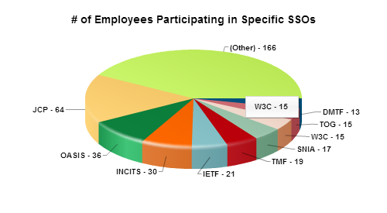







Oracle Standards Body Participation
Oracle currently has 323 employees actively involved in 422 technical working groups, and 69 administrative or policy committees
A Bias Towards Leadership: Oracle employees serve in 283 leadership positions across 102 standards setting organizations

Slide 4


Must improve Sharing of Threat and Risk information across all domains, sectors, industries and audiences
The reality is we live in a world where billions of connected people and devices generate huge quantities of data associated with Natural Disasters, Terrorist Acts, Cyber Crimes, Social Engineering and others.
Communities of interest must:
Collect voluminous amounts of fragmented data
Quickly parse out what is valuable
Integrate and make sense of it
Respond
Appropriately

Slide 5
A (Pessimistic) View on Cyber Security
Advanced Persistent Threats continue to grow & evolve with no retribution
Ungoverned geographies and/or no extradition agreements
Crimeware/ransomware growing from established market and model
+800 criminal forums with ~1.5M participants doing rapid collaboration
Cyber SME skills shortage
Still defining job descriptions, org roles, establishing curriculums, compensation, etc.
Unclear what makes for “Reasonable Standards of Care”
Who is or should (anyone) be accountable when something happens

Slide 6

Drivers for Threat and Risks Information Sharing
Notes:
It’s as simple as ABC. I do still think like a child.

Slide 7






“A” is for Assets

Slide 8






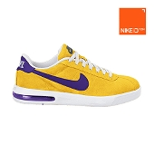








“B” is for Brand

Slide 9
Compliance
NIST
FIPS 140-1 & 201
OFAC
PCAOB Audit
21CFR Part 11
CA SB 1386
GLB
C
WA SB 6043
Sarbanes-Oxley
ND SB 2251
FTC 16 CFR 314
IL SB 1479
HIPAA
PA SB 705
PIPEDA
EU Privacy
Patriot Act
Basel II
HSPD-12
FERPA
FISMA PL107-347
BSA
Notes:
This is why it’s hard…

Slide 10

From Mistakes to Malicious
MISTAKES
Accidental deletes
Unauthorized disclosures
MISUSE
Privilege Abuse
Curiosity
Leakage
Social Engineering
Denial of Service
Sophisticated Attacks
Data Theft
Loss to Business
Impacts Reputation
MALICIOUS
Source: Adapted from Kuppinger Cole Presentation, March 2013

Slide 11


Oracle - Data Informing Smarter Action Everywhere
Standards
Data
Software
Platform
Infrastructure
Technologies

Slide 12
Oracle Data and Information Services Today
Pre-Negotiated Data Rights
Rights Management
Privacy
Legal & Compliance
Brand Data Collections – Ad Tech
7.5 trillion marketing data transactions on 1B monthly profiles
Over 700 million unstructured messages daily from 40 million sites in 19 languages
240 million B2B companies and contacts worldwide.
Oracle
Data Services & Exchange

Slide 13
Information flow: Cross Domain, Industries & Audiences
1
2
3
4
Data Ingestion
Value Extraction
Rights Management
Data Activation
Structured/Unstructured
Anonymous/PII
Offline/Online/Mobile/Video Search/Social
1st/3rd Party
Real-Time/Batch/Server Side
Public/Acquired
Cross Channel Matching
Signal Extraction: Intent, Sentiment, Themes, Topics
Quality Assurance: Data Cleansing, De-duplication, Verification, etc.
Rights Management
Provisioning
Privacy
Legal & Compliance
Pricing & Economics
Payment/Revenue Management
Integrated/Standalone
Cross Channel Marketing
Social Insights
Sales Database Enrichment
Industry Benchmarking
Analytics/Modeling
Cross Channel ID Unification
Data Computation
Cross Channel ID Unification
Scalable Infrastructure

Slide 14
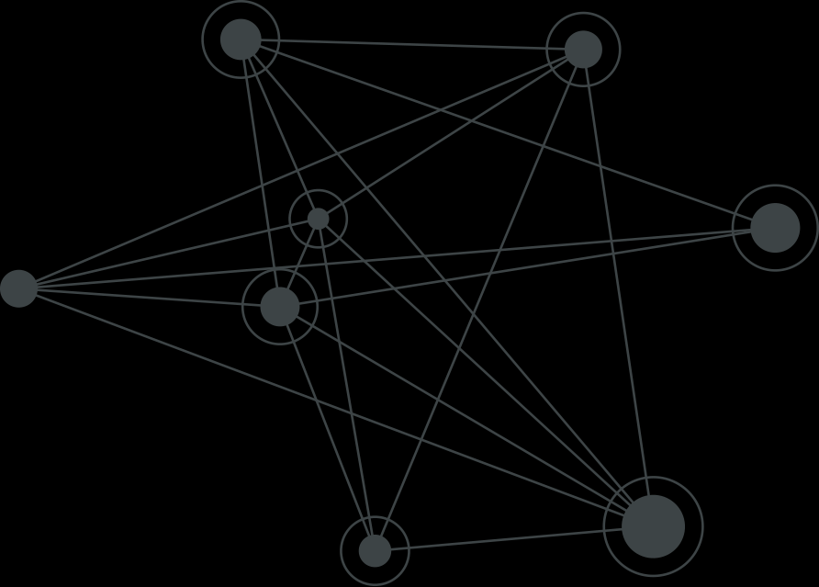

Link Data
Authors/
Posts
Household
Level
CRM
Offline
Sources
Unstructured Social
Reviews
Forums
Contacts
Registration ID
2nd Party Cookie Data
Blogs
Customer
Data
Brick
&
Mortar
Cookies
Mobile
Web
Email
3rd-Party
Cookie
Data
1st-Party
Cookie
Data
Other
Emerging
Channels
Matched
Statistical
IDs
Mobile
App
ID
Mapping
Over the Top
Boxes
Mobile
Web
Addressable
TV
Google
Ad ID
Online
Sources
Microsoft
ID
Set Top
Boxes
Notes:
Example use case

Slide 15




Customer Benefits
Actionable Data
Data driven qualification and prospecting
Discover the right People
Enrich customer Data
Hot Topics
Key Indicators
Sentiment
Language Indicators
Themes and Terms
Timely
Available
Accurate
Consistent
Reliable
Secure
Link Data and Graph Analytics the key
Notes:
Incorporate more on Mobile, plans, where we are?

Slide 16
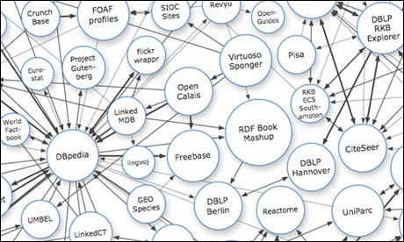
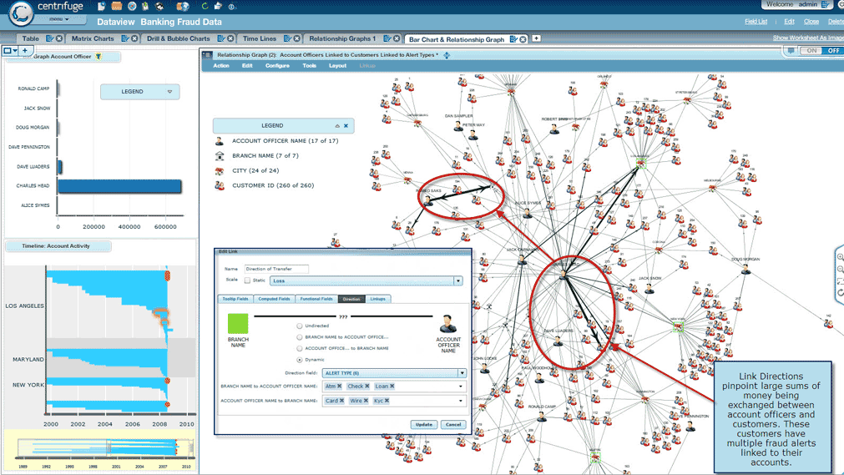

Link Data and Graph Analytics Enabling Cross Domain Information Sharing of Risk & Threat Information Operating at the speed of Wire

Slide 17
Why Link Data and Graph Analytics for Information Sharing
Enable Secure Access to all data and Undercover New Intelligence
Integrate data access across the communities and domains without moving the data.
Establish common vocabulary for data access, discovery and search
Enforce fine-grained information security to meet entitlements and compliance
Uncover new relationships, properties/sentiments and behaviors of current threats
Anticipate emerging threats based on key indicators, behaviors and trends
Respond appropriately based on situation

Slide 18
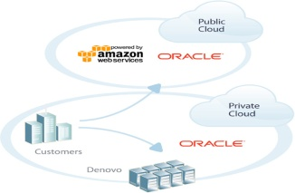
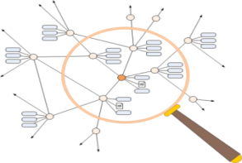
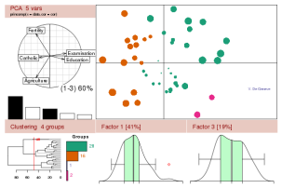
Link Data and Graph Use Cases
Unified metadata model across enterprise domains
Validate semantic and structural consistency
Linked Data &
Data Integration
Text Mining & Entity Analytics
Find related content & relations by navigating connected entities
“Reason” across entities
Social Media
Analysis
Analyze content using
integrated metadata
Blogs, wikis, video
Calendars, IM, voice
Notes:
18

Slide 19
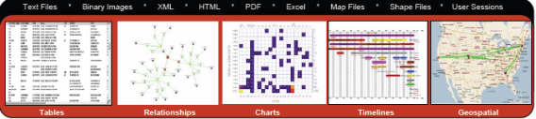
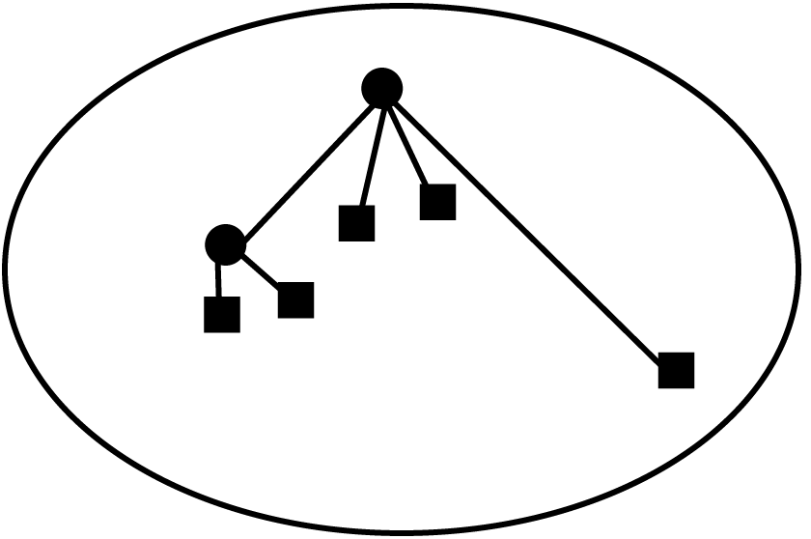
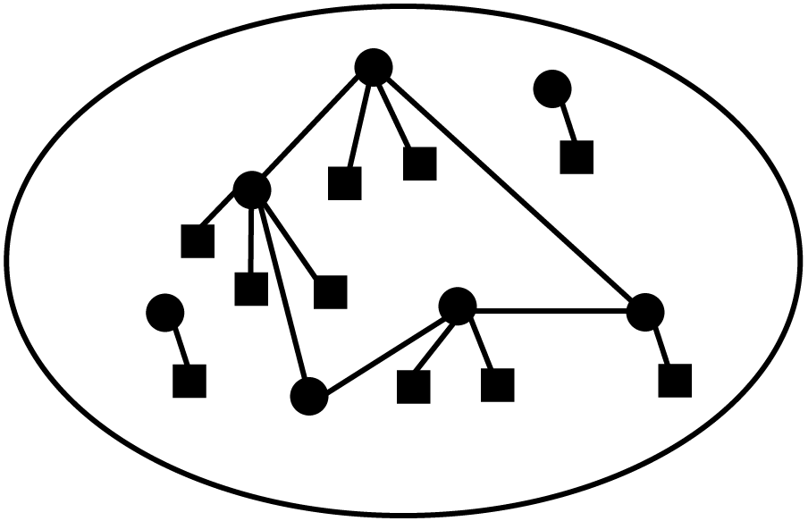


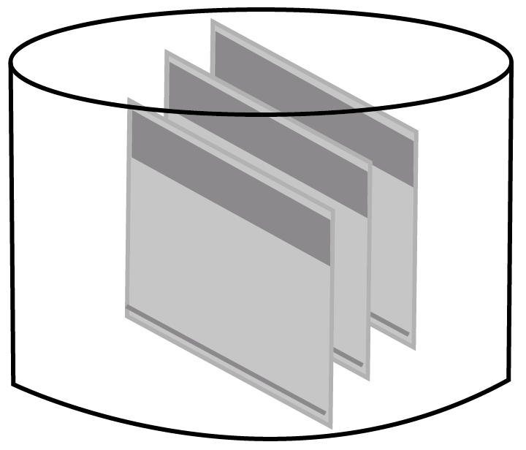















Link Data for Enterprise
Access & Presentation Layer
Enterprise metadata registry
(integrated graph metadata)
Index
Data Servers
Event Server
Big Data Appliance
Content Mgmt
BI Server
Data Warehouse
Data Sources / Types
Human Sourced
Information
Machine Generated Data
Social Media
Subscription Services
Transaction Systems
RDF Triples (or RDBMS/XML)

Slide 20


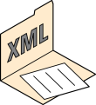

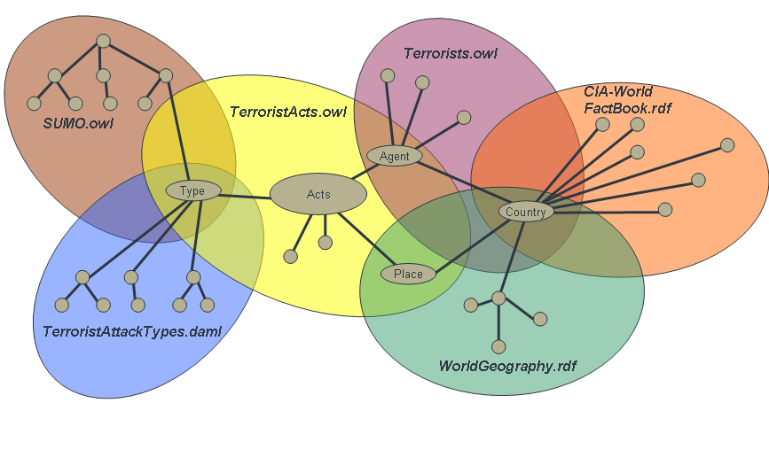



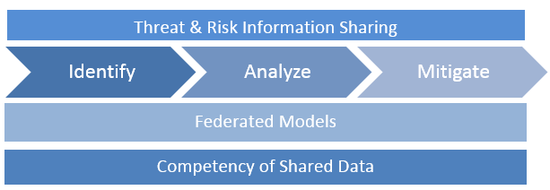
National Risk & Threat Intelligence Scenario
Unified Big Data Platform
Extracted Entities & Relationships
Information Extraction
Feature Extraction, Term Extraction
Nationality: Somalian
Has
Country: UK
Group: Al Shabab
Member of
Person: Abduwali Abdukhadir Muse
Currently resides
Country: Morocco
Search, Presentation, Report, Visualization, Query
Supports
Link ?
Link ?
Person: Chehab Abdouljamid Bouyaly
Currently resides
Ideology: Islamist
Member of
Financial Data
Supports
Group: ?
Member of
Person: ?
Group: al Qaeda
Has
Currently resides
Telephone Records
Nationality: Pakistani
Country: Pakistan
RDF
Intelligence Ontologies
Internet Traffic
SQL/SPARQL
Enterprise Data
images
Spatial
Documents
Data Sources
Contents Repository
Databases
Web resources
Blogs, Mails, news, RSS feeds

Slide 21
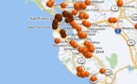
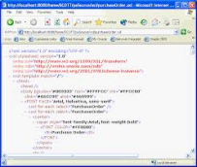


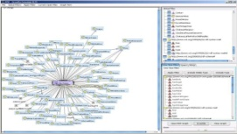

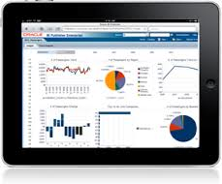
Unified Big Data Platform
All data types, interoperable, secure, consistent, accessible at scale
SPATIAL
DOCUMENTS/
XML
SEMANTIC
DRIVEN QUERY
Hadoop
Native Whole Earth 3D Model
Full OGC and ISO Compliance
Extreme Scale
Compatible with all major GIS Tools
Geodetics/Topology/Planar Networks
GeoRaster/Point Clouds/LIDAR
Full Native XML Support
Full Support for XML Ingest
XQuery, DOM
SQL XML, XQJ
XSLT
NameSpaces Support
Ontological Knowledge Layer
Self-Service Answers
Rapid Creation
Mobile Push
Free Form Discovery
Flexible Visualization
Parallel Distributed Processing
Compute and Storage Co-resident
Map Reduce Processing
NoSQL
Bi-Directional HDFS Connectors
Big Data SQL
GRAPH
JSON
Data Discovery
& Visualization
ADVANCED
SQL
Native Extreme Scale Graph DB
10-30x Faster than Neo4J
SPARQL1.1, SPARQ/SQL
GeoSPARQL
Jena, Sesame, Joseki WS
W3C: RDFS, OWL2 RL-EL, SKOS
RDF, RDB2RDF, RDFa
Full Native JSON Support
NoSQL Key Value
Direct Java Get/Put Commands
SQL overtop JSON
Rest WS
New SQL JSON Commands
No Schema
Auto discovery and categorization
Runs on HDFS
Flexible Visualization
Easy Triage of New Data Sets
Mash up data sets
Extensible Visualization Options
In Database Data Mining
Advanced Algorithm Support
Predictive Analysis and Modeling
Enterprise R Statistics
Security
Data Pattern Matching
Text Mining and Processing

Slide 22
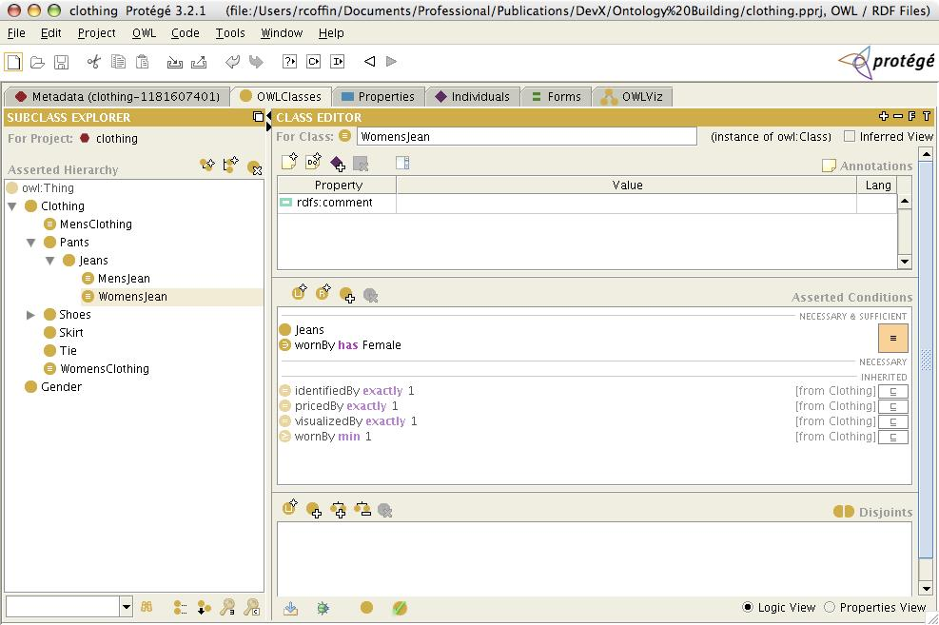
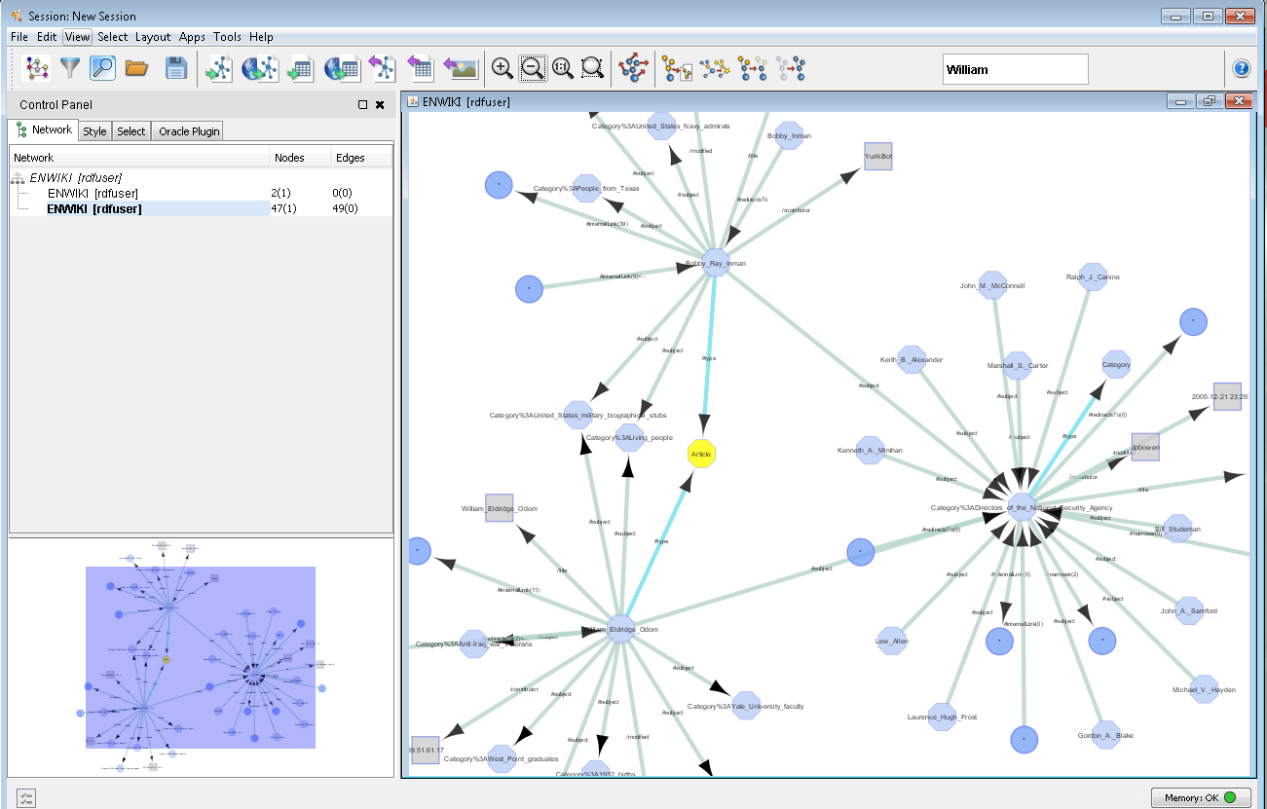
RDF Semantic Graph: Graph Visualization & Modeling Support Open and Standards Based
Semantic Modeling
Graph Visualization
Protégé
Cytoscape
22
Oracle Confidential – Internal/Restricted/Highly Restricted

Slide 23
Innovations in Risk & Threat Analytics Operating at the Speed of Wire

Slide 24


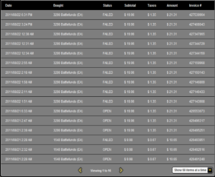









Graph Analysis – Model Data as a Graph
Graph analysis considers relationships and properties between entities
Straight forward concept, but difficult to implement
Object Recommendation
Influencer Identification
Community Detection
Graph Pattern Matching
customer
items
Purchase Record
Communication Stream (e.g. tweets)

Slide 25


Oracle’s investment in Link Data, Graph & Analytics
Simplifying graph analytics
Standards based: W3C
Strong partner ecosystem
Optimized and scalable solutions
Security: Security labels at “triple” level (OLS).
Transactional: Concurrent loading and updates
Manageable: Use existing DB tools, utilities and expertise
Multi-type support: graph, relational, search, geospatial
Multi-platform: Relational database, NoSQL, Hadoop
Notes:
25

Slide 26
Built-in Algorithms and Graph Mutation
Provide rich set of built-in (parallel) graph algorithms.
as well as parallel graph mutation operations
The original graph
a
Detecting Components and Communities
Ranking and Walking
a
d
f
Left Set: “a,b,e”
a
d
Pagerank, Personalized Pagerank,
Betwenness Centrality (w/ variants),
Closeness Centrality, Degree Centrality,
Eigenvector Centrality, HITS,
Random walking and sampling (w/ variants)
b
g
f
g
Tarjan’s, Kosaraju’s,
Weakly Connected Components, Label Propagation (w/ variants), Soman and Narang’s
Spacification
d
b
e
e
g
h
i
b
c
i
c
e
h
Create Undirected Graph
Create Bipartite Graph
Filter-Expression
c
i
Evaluating Community Structures
Path-Finding
a
Hop-Distance (BFS)
Dijkstra’s,
Bi-directional Dijkstra’s
Bellman-Ford’s
d
f
Conductance, Modularity
Clustering Coefficient (Triangle Counting)
Adamic-Adar
g
Sort-By-Degree (Renumbering)
d
b
e
g
∑
∑
b
e
i
e
b
d
i
a
f
c
g
h
h
c
i
Link Prediction
Other Classics
SALSA
(Twitter’s Who-to-follow)
Vertex Cover
Minimum Spanning-Tree(Prim’s)
Filtered Subgraph
Simplify Graph

Slide 27
Subgraph Isomorphism Problem
Query Graph Q
Data Graph G
A
B
C
X
Y
Z
Y
Y
Z
B
B
C
A
B
Z
X
Z
Z
Z
X
C
B
B
Y
Z
Y
Isomorphism Criteria:
Structure of the graph matches
Properties on nodes and edges match
Z
A
C
A
X
Z
Z
X
B
B
The Problem:
Find all subgraphs of G that are isomorphic to Q
Subgraphs of G that are isomorphic to Q

Slide 28

World’s Fastest Big Data Graph Benchmark 1 Trillion Triple RDF Benchmark with Oracle Spatial and Graph
World’s fastest data loading performance
World’s fastest query performance
Worlds fastest inference performance
Massive scalability: 1.08 trillion edges
Platform: Oracle Exadata X4-2 Database Machine
Source: w3.org/wiki/LargeTripleStores, 9/26/2014
Oracle Database 12c can load, query and inference millions of RDF graph edges per second

Slide 29





Driving Information Access Through Technology Innovation
Use the Right Tool for the Job and benefit from the Power of “AND”
Hadoop
NoSQL
Relational
Change the Business
Disrupt competitors
Disintermediate supply chains
Leverage new paradigms
Exploit new analyses
Scale the Business
Serve data faster
Meet mobile challenges
Scale-out economically
Run the Business
Integrate existing systems
Support mission-critical tasks
Protect existing expenditures
Ensure skills relevance

Slide 30
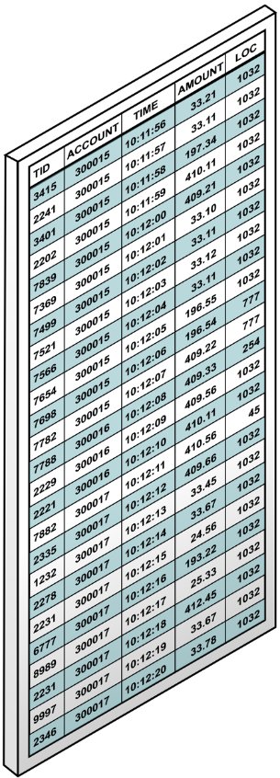
SQL Based Pattern Matching within Database
Simplifying Analytics for complex Big Data collections
Select * from
Transactions MATCH_RECOGNIZE (
…
PATTERN(S X{2,4} Y)
DEFINE S AS (type = T),
X AS (loc = PREV(loc)),
Y AS (loc != PREV(loc))
…
)
Clickstream logs:
sessionization, search behavior
Business transactions:
fraud detection, stock analysis
Sensor data:
Automated observations and detections
Complex results from simple requests
Ascending Order
Possible fraudulent
banking transactions
defined as regular
expression

Slide 31
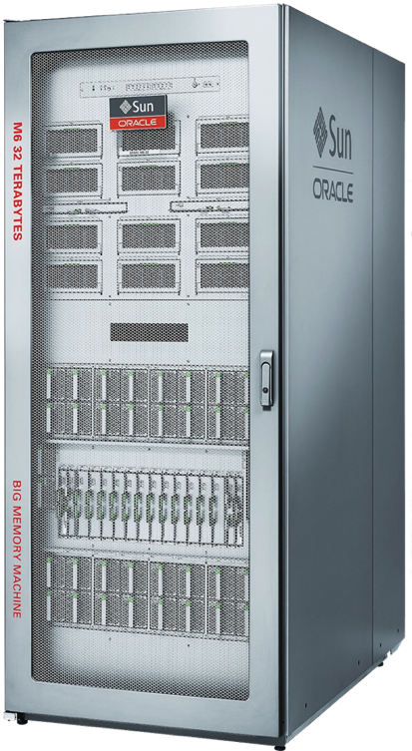

Terabyte Scale Computing
Use Case
218 Billion Records
Search - “titanium”
Match - 2,054,141 records
Time 0.64 seconds
M6-32 SuperCluster -
Big Memory Machine
32 TB DRAM
32 Socket, 384 Cores
3 Terabyte/sec Bandwidth
341 Billion records scanned per second
Hundreds of billions records scanned per second
In-Memory Column Store
1 Rack - 1000X Faster

Slide 32
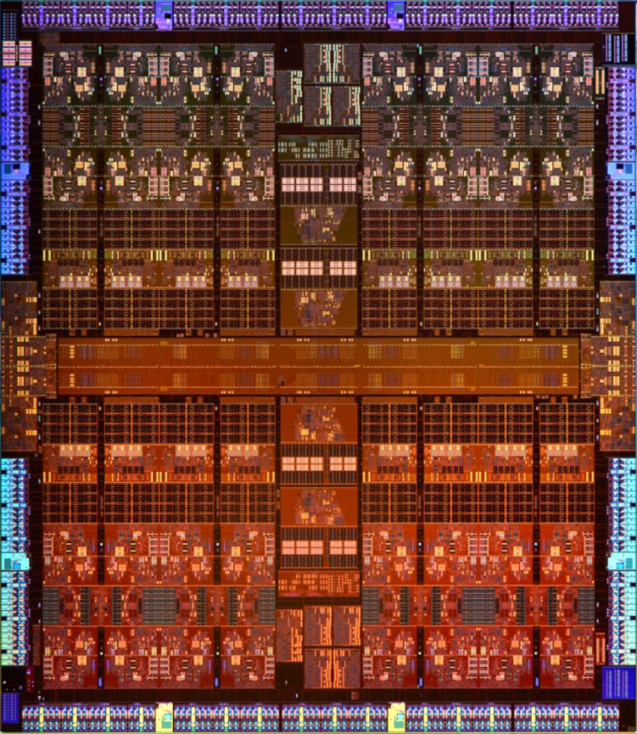
The Ultimate Software Optimization: Hardware
Performance
DB In-Memory Acceleration Engines
Reliability
Application Data Integrity
Software
in Silicon
Capacity
Compression Engines
Coming in 2015

Slide 33
Performance: Database In-Memory Acceleration Engines
SPARC M7
SIMD Vectors used by Oracle DB In-Memory were designed for graphics, not database
New SPARC M7 chip has 32 optimized database acceleration engines (DAX) built on chip
Independently process streams of columns
E.g. find all values that match ‘California’
Up to 170 Billion rows per second!
Like adding 32 additional specialized cores to chip
Core
Core
Core
Core
Shared Cache
DB Accel
DB Accel
DB Accel
DB Accel
32 Database Accelerators (DAX)
2.7 Trillion rows per second on a 16 Socket Server

Slide 34
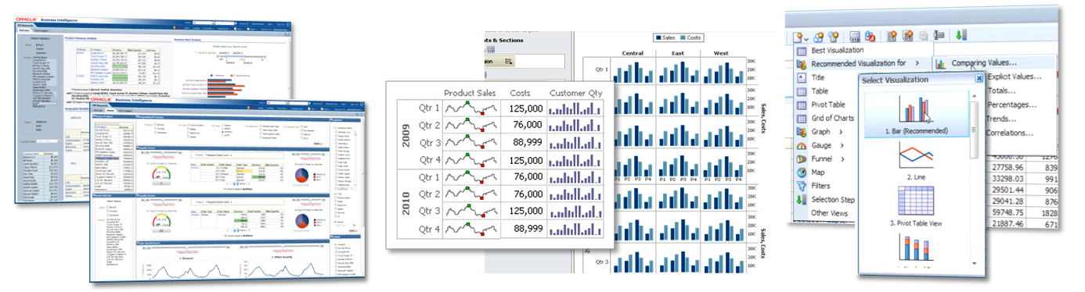
Analyst Driven Answers from Semantic Data Layer
Speed of Thought Interactive Analysis
Highly Interactive Analysis
Free Form Data Exploration
High Density Visualizations
View Auto Suggestions
Contextual Actions
All on Mobile

Slide 35
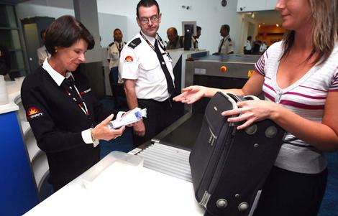






Cross Domain Information Sharing Platform
Domain 1
Domain 2
Domain 3
Domain 4
Domain N
Identity and Access Management Fabric
Cross Domain Information Platform
Relational – Object - XML – Spatial – Text – RDF – Graph – Imagery – Secure Files
Campaigns
Exploits
Indicators
Incidents
Actors
Actions
UCDMO
Baseline
Cross Industry, Sector and Classification Levels

Slide 36

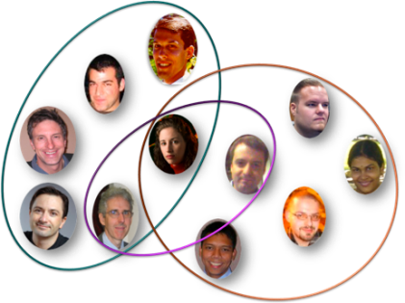
Keeping up with Data Growth and Demand for New Intelligence!
Reshape the Mission
Data As a Service – Create new intelligence that provides advantage
Link Data – Integrate data and common vocabulary to navigate, search and retrieve
Graph & Advanced Analytics – Undercover and Illuminate new intelligence that can reshape the mission
Security – Enabler of Entitlements and Compliance
Standards & Innovations – The foundation to meeting the outcomes
Software
Data
Platforms
Infrastructure
New Outcomes

Slide 37
Summary - Timely & Reliable Information is Not Optional
Drive information sharing and compliance standards
Establish a common vocabulary of meanings and terms
Enable Analyst or System to decipher and connect dots in a meaningful way
Tag and Secure data for information sharing across all “Domains”
Build a strong community and partner ecosystem
Drive timely decisions through consistent, secure, accurate Information
Operate at the extreme speed

